Slide 1



Energy, Water, and Greenhouse Gas Emissions
A Trade Off Analysis
By: Colin Towne Mentor: Dr. Ching-Hsun Huang
Northern Arizona University
School Of Forestry

Slide 2
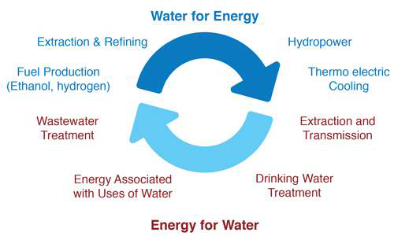
Water, Energy, Emissions Nexus
The greatest use of water withdrawals in the United States is for thermoelectric power plants.
The U.S. Geological Survey (USGS) estimates that 45% of total U.S. freshwater withdrawals were for electricity generation (Maupin, 2010)
Providing freshwater uses energy
Producing energy uses water
Producing energy emits greenhouse gases
Reducing water use or pollution affects energy production
(Belesky, 2014)

Slide 3
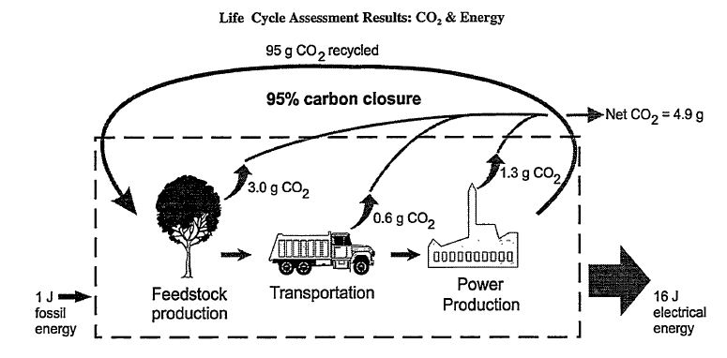
Intro-Life Cycle Assessment Overview
Analytical tool for quantifying the emission, resource consumption, and energy use, (environmental stressors) that are associated with converting a raw material to a final product.
Cradle-to-grave
Energy & material flows of all processes necessary to operate (Mann & Spath, 1997)
All environmental burdens connected with a product assessed, back to raw materials and down to waste removal (Klopffer,1997) and (ISO, 1997)

Slide 4
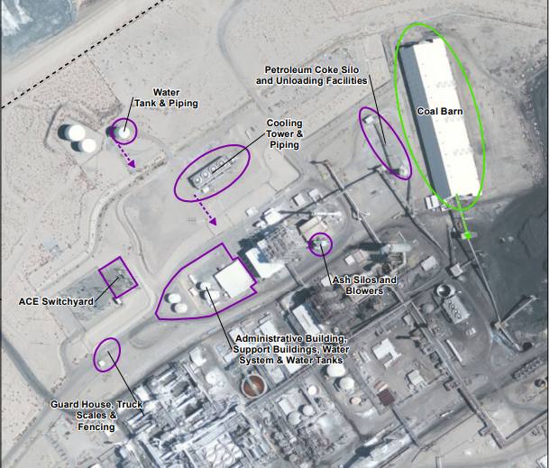
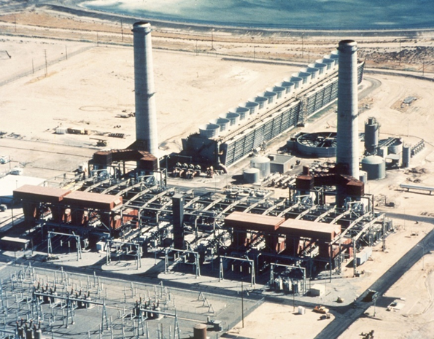
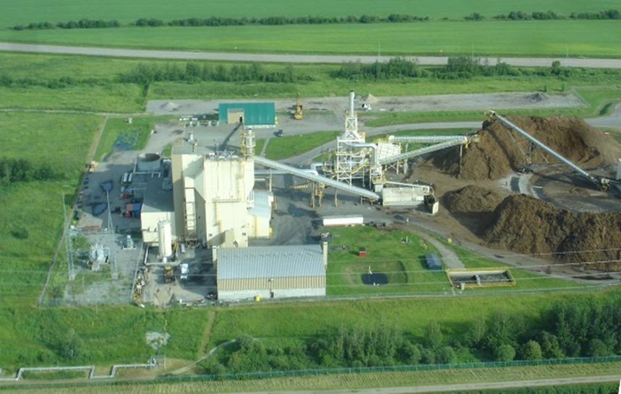
Intro-Coal, Biomass, and Natural Gas
Focus on Power Production Process
Power plants generate heat from their fuel, use that heat to boil water and produce steam, to then turn turbines
Fuel sources looked at:
  BIT - Bituminous Coal
  NG - Natural Gas
  WDS - Wood Waste Solid
(ACE, 2014)
(S.C. Edison, 2018)
(Biomass Magazine, 2014)

Slide 5
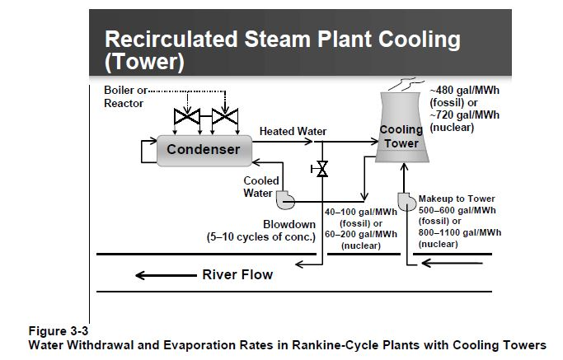
Intro- Cooling
Water cools and condenses the steam generated by burning fuels, and replenishes lost steam generated in the boilers
Used for cleaning
Types of cooling
Once through
Recirculating
Dry
Pond
Hybrid
Withdrawals vs. Consumption

Slide 6
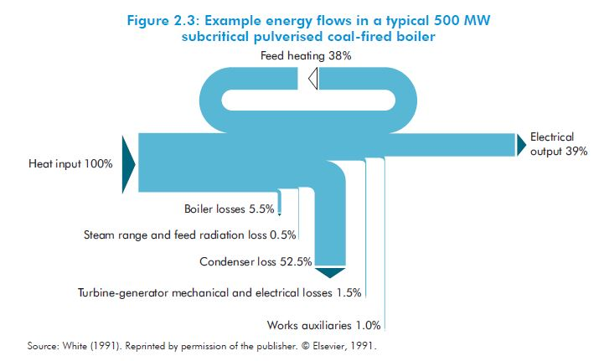
Efficiency
Efficiency comparison variables (CIAB, 2010)
Fuel type and moisture content
Cooling system
Ambient air temp./humidity
Etc.
Heat Rate (EIA, 2017)
A measure of efficiency for conversion of fuel into heat, and heat into electricity
The amount of energy used by an electrical generator or power plant to generate one kWh of electricity.
Efficiency = 1 kWh (Btu) / Heat Rate (Btu)

Slide 7
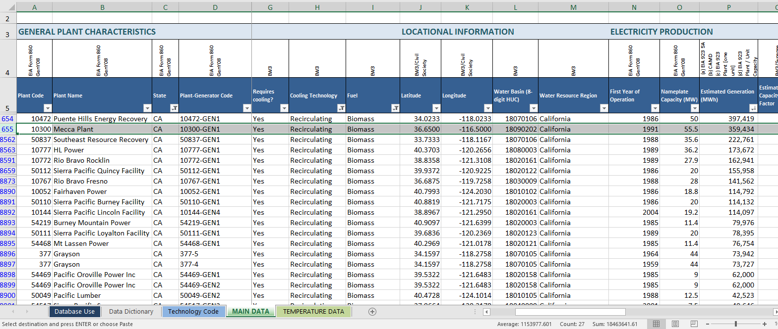
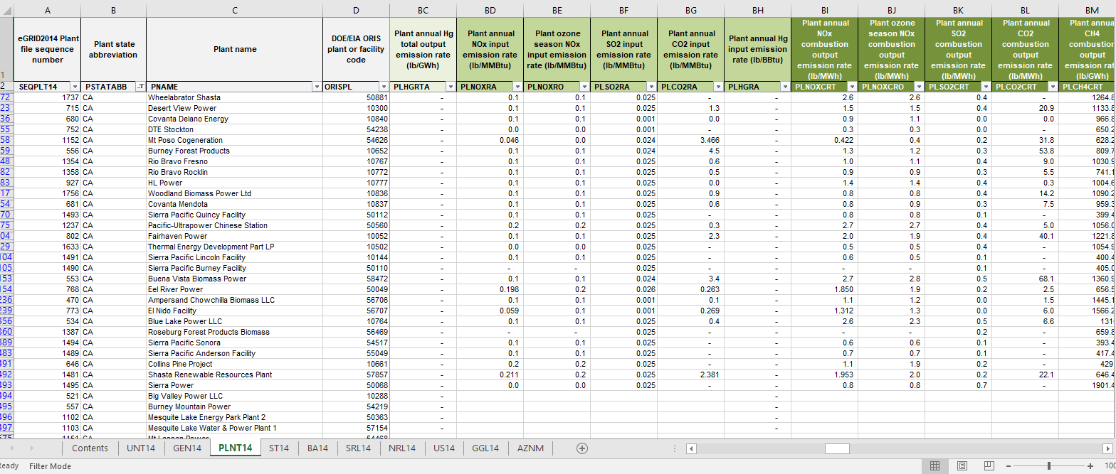
Data
Best Available Data- 2014
Water Data
  EIA (Energy Information Administration Form 923 Schedule 8D – Annual Basis
  Union of Concerned Scientists, Energy and Water in a Warming World- 2011
Emissions Data
  EPA (Environmental Protection Anency)
  eGrid (Emissions & Generation Resource Integrated Database)
Energy Data
  EIA Form 860

Slide 8
Results- Power Plant Water Use and Emissions
Identical Cooling Technology
  Recirculating cooling tower
Identical Prime Mover – the machine that turns the generator
  Steam Turbine
Similar Net Generation
  ~300,000 MWh

Slide 9
Results- Efficiency
eGRID Nominal Heat Rate-
  Total annual heat input / plant annual net generation

Slide 10

Discussion- What does it mean? /Continued Research
More Research Needed:
  Feedstock Process Analysis
  Transportation Process Analysis
  Economic Analysis
  County specific Analysis in AZ
Shows the productive capabilities of Biomass power generation in reducing environmental impacts as compared to coal and natural gas power generation

Slide 11
Knowledge Gap
consumption and withdrawal rates of individual power plants are characterized by inconsistencies and scarcity
water withdrawal and consumption values that are far below or above detailed engineering studies of water use in power plants
National and regional evaluations of energy, water, and pollution will remain challenging until collecting data by federal agencies has improved

Slide 12



Acknowledgements
Dr. Ching-Hsun Huang
Dr. Han-Sup Han
Dr. Nadine G. Barlow
Kathleen Mary Stigmon

Slide 13
References
Fthenakis, V. and Kim, H.C. 2010. Life-cycle uses of water in U.S. electricity generation. Elsevier Ltd. Renewable and Sustainable Energy Reviews 14 2039-2048.
Mann, M.K. and Spath, P.L. 1997. Life Cycle Assessment of a Biomass Gasification Combined-Cycle Power System. National Renewable Energy Laboratory.
Spath, P.L., Mann M.K., and Kerr D.R. 1997. Life Cycle Assessment of Coal-fired Power Production. National Renewable Energy Laboratory.
Klopffer, W. 1997. Life Cycle Assessment, From the Beginning to the Current State. ESPR- Environ. Sci. & Pollut. Res. 4 223-228.
International Organization for Standardization. 1997. Environmental management- Life cycle assessment- Principles and framework. ISO 14040.
Coal Industry Advisory Board. 2010. Power Generation from Coal, Measuring and Reporting Efficiency Performance and CO₂ Emissions. International Energy Agency.
U.S. Energy Information Administration. 2014. Annual Electric Generator Report. Form EIA-860.
U.S. Energy Information Administration. 2014. Power Plant Operations Report. Form EIA-923.
U.S. Environmental Protection Agency. 2014. Emissions & Generation Resource Integrated Database (eGRID).
Southern California Edison Company's Coolwater PACE 520 Power Plant. 2018. RICHES of Central Florida https://richesmi.cah.ucf.edu/omeka/items/show/7743..
Simet, A. 2014. Greenleaf secures $100 million to buy, build more biomass plants. Biomass Magazine Accessed 2018. http://biomassmagazine.com/articles/10587/greenleaf-secures-100-million-to-buy-build-more-biomass-plants
ACE Cogeneration Company. 2014. ACE Project Decommissioning Plan. California Energy Commission. Docket No. 88-AFC-1C.
Belesky et al. 2014. Food and Water Security: Our Global Challenge Landmark Study. Future Directions international Research Institute
Maupin M.A. et al. 2010. Estimated Use of Water in the United States in 2010. U.S. Department of the Interior, U.S. Geological Survey. Circular 1405.

Slide 14
Questions?

